Slide 1
Deep Neural Networks
Parameters vs
Hyperparameters

Slide 2
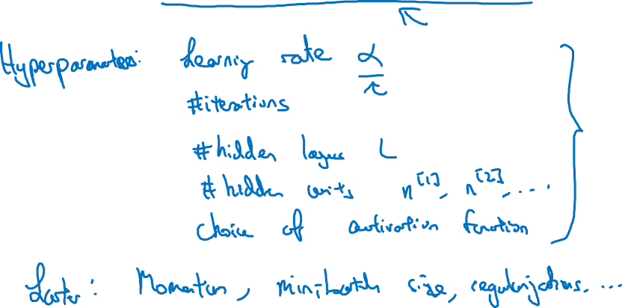
What are hyperparameters?
Parameters: $W^{\left[1\right]} ,{ b}^{\left[1\right] }, W^{\left[2\right]} ,b^{\left[2\right] },W^{\left[3\right] }, b^{\left[3\right] }…$

Slide 3

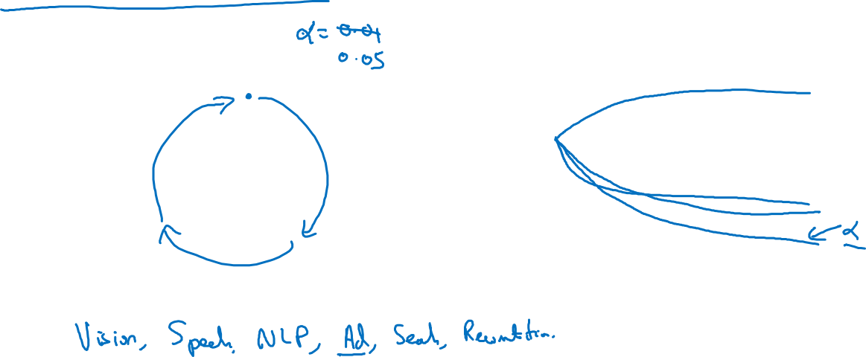
Applied deep learning is a very empirical process
Idea
cost $J$
Experiment
Code
# of iterations

